Slide 1
From Sketch and Text to 3D Scene

Slide 2
Introduction
People possess the power of imagery that allows them to turn descriptions of scenes into imagery. The conceptual simplicity of generations pictures from descriptions and sketches has spurred the desire to make systems capable of this task.
Most of the current 3D scene design systems require the user to learn complex manipulation interfaces to perform the above task. However, the use of a simplistic sketch and natural language makes the application of it far more ubiquitous.

Slide 3
Background of Related Research

Slide 4
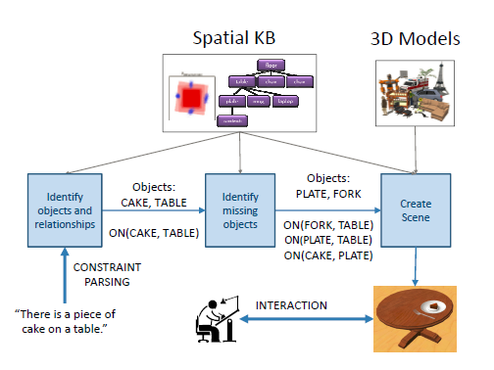
Interactive Learning of Spatial Knowledge of Text to 3D Scene Generation

Slide 5
Interactive Learning of Spatial Knowledge of Text to 3D Scene Generation
Natural language Objects present and explicit relations
Objects and explicit relation compares with database to get implicit relations
Implicit relations candidate scene
Candidate scene desired scene

Slide 6
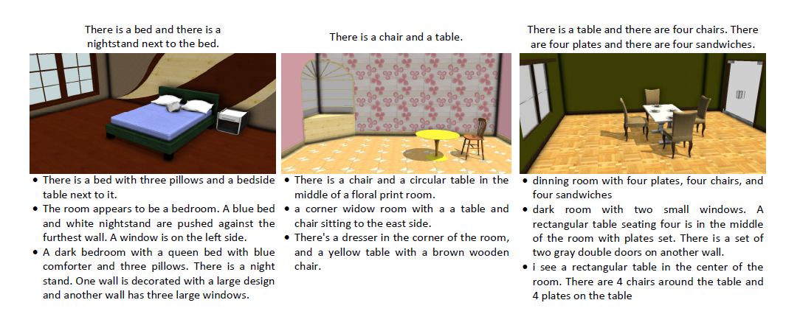
Text to 3D Scene with Rich Lexical Grounding

Slide 7
Text to 3D Scene with Rich Lexical Grounding
Designs a database of 3D scenes with accompanying sentences.
A classifier is then trained and weights of lexical features for use in scene generation are extracted
Furthermore, it combines this learned approach with a rule-based one using the Stanford CoreNLP pipleline
This system to used to derive spatial relationships

Slide 8
Sketch2Scene: Sketch-based Co-retrieval and Co-placement of 3D Models
This paper requires the use of repository of 3D scenes rather than a database of individual 3D models. It uses the Google 3D Warehouse
Generates a graph called the structural graph G = (V,E) with each node v_{i} Є V representing an object category and each edge e_{ij} Є E representing the pairwise relationship between v_{i} and v_{j}
It address the sketch-based co-retrieval by first retrieving a small set (N) of candidate objects from the repository independently for each sketch. Consequently, it goes on to find the optimal combination such that it is as close to the repository scene as possible
Solves the co-placement task in a manner similar to one used in creating the structural group. Defines an arrangement cost function to iteratively place the objects

Slide 9
Idea is to take freehand sketch, depicting a desired scene, and turn it into a valid, well arranged scene of 3D model.
Classic works focus on improving individual object’s retrieval performance. Also previous works had moving it concentration on pair-wised object relationships.
State of art work expand this idea to multi-object relationship that is co-occurrence.

Slide 10
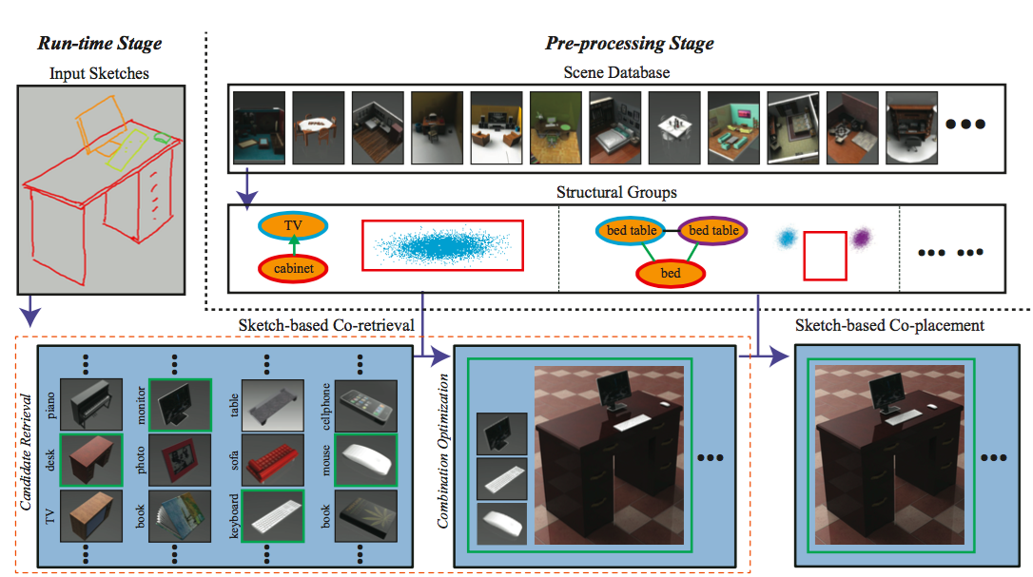
Sketch2Scene methods

Slide 11
Sketch Co-retrieval
Create a continuous object database
Create matching score using contours of object and sketches
Combination Optimization problem based on scale consistency, weighted sketch matching and spatial relations
Beam search for speeding up

Slide 12
Challenges

Slide 13
Need for a stronger understanding of NLP concepts
Implicit relation information is lacking in natural language
Need for human interaction
The structural graphs created in sketch2scene are partially human driven
Sketches that vary largely in similarity from 3D scene repository give poor results

Slide 14
Methods to be implemented

Slide 15
Methods to be Implemented
Extract objects and explicit constraints from the text
Comparing the objects and constraints with the database, the likely implicit constraints are obtained
Extract the structural graphs from the objects and constraints and the sketch
This gives a more complete structural graph (Not manually driven)

Slide 16
Having obtained the structural graphs, we implement co-retrieval and co-placement
This gives us a more complete solution to the task of 3D scene
Minimal user involvement

Slide 17
References
[1] Angel. etc. "Text to 3D Scene Generation with Rich Lexical Grounding, 2015.
[2] Kun. etc, “Sketch2Scene: Sketch-based Co-retrieval and Co-placement of 3D Models, 2013
[3] YouTube link: https://www.youtube.com/watch?v=cyiWLAnhBjY
[4] Interactive Learning of Spatial Knowledge for Text to 3D Scene Generation
[5] Angel, etc, “Semantic Parsing for Text to 3D Scene Generation”

